Slide 1
Real Time Network Anomaly Detection using Big Data
Ayush Panara (1641005)
Yash Mehta (1641063)
Umangkumar Patel (1641039)

Slide 2
Introduction
Nowadays, Cyber-attacks have become very systematic and complex. The high computation volume and consistent changes in network traffic have made it harder to break down information and recognize anomalous practices inside.
Thus, large data techniques have turned out to be essential to identify attacks and block them. Traditional frameworks are inefficient because they mostly rely on signature based structure they can’t distinguish latest attack vectors and it is hard to carry out operations and examination of tremendous measure of security information at the same time.
Notes:
Unilever is Already using Emtotion detection

Slide 3
10,00,000
Events/day

Slide 4
Dataset
UNSW NB-15
Created by the IXIA PerfectStorm tool in the Cyber Range Lab of the Australian Centre for Cyber Security (ACCS) for generating a hybrid of real modern normal activities and synthetic contemporary attack behaviours.
The dataset contains nine type of attack categories like Fuzzers, Analysis, Backdoors, DoS, Exploits, Generic, Reconnaissance, Shellcode and Worms.
2 Million+ Records

Slide 5
Methodology
Statistical analysis of the observations
Pre-processing to get some insights on the dataset
Preliminary information derivation
Correlation for features
Column-Specific Transformations
Classification Techniques

Slide 6
Classification
Gaussian Naive Bayes(GNB)
Artificial Neural Networks(ANN)
Decision Tree
Random Forest

Slide 7
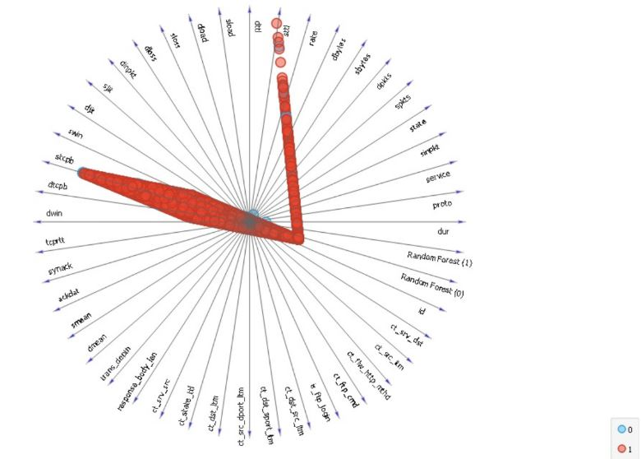
Final Results
Initial Raw Data

Slide 8
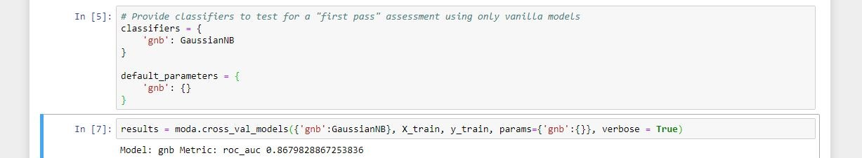
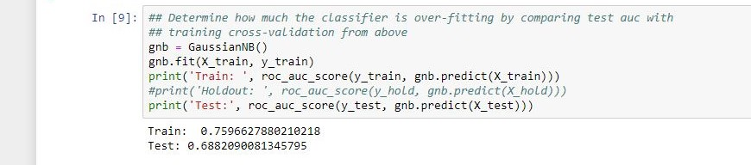
GNB

Slide 9
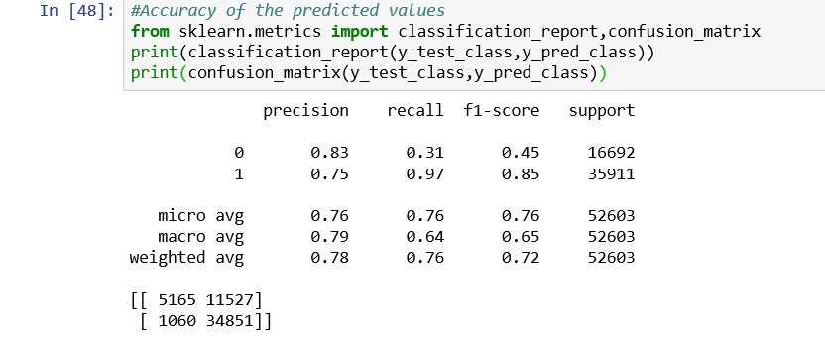
ANNs

Slide 10
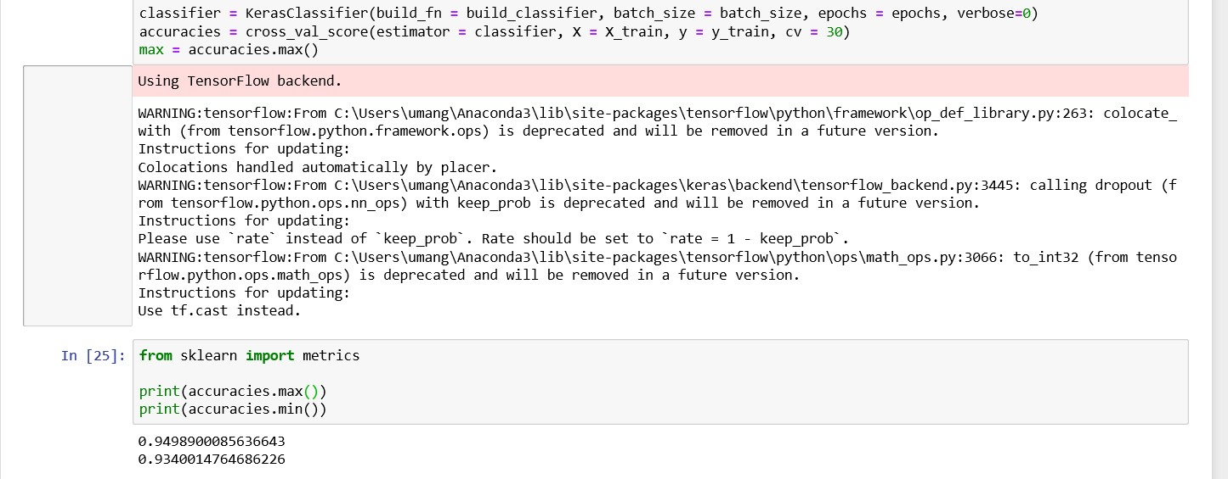
ANNs

Slide 11
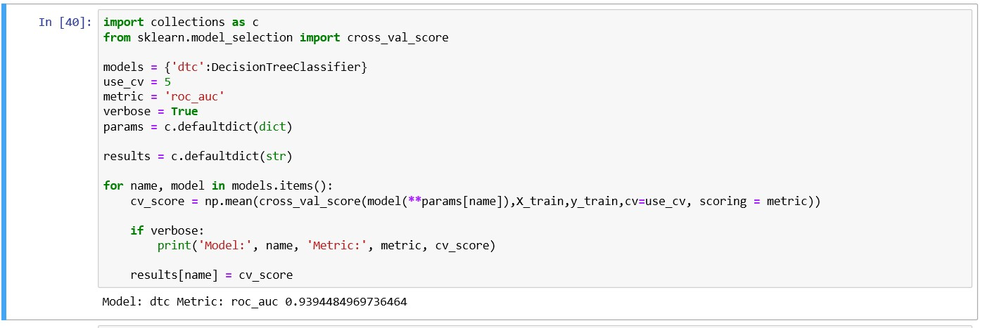
Decision Tree

Slide 12
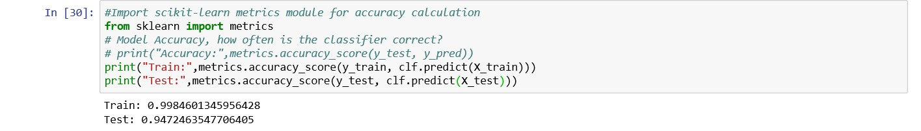
Decision Tree

Slide 13
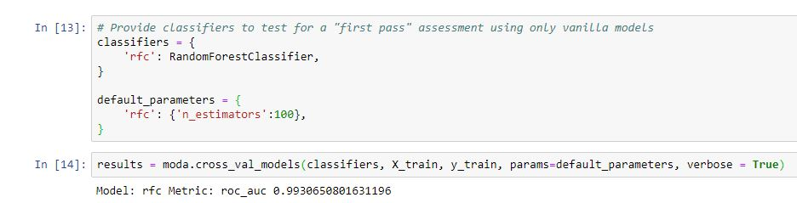
Random Forest Accuracy on test dataset

Slide 14
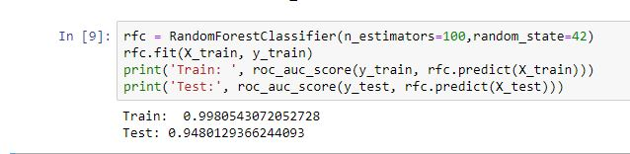
Random Forest Accuracy on test dataset

Slide 15
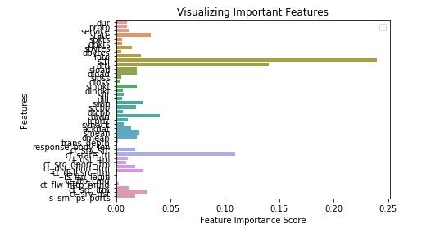
Random Forest Important Features

Slide 16
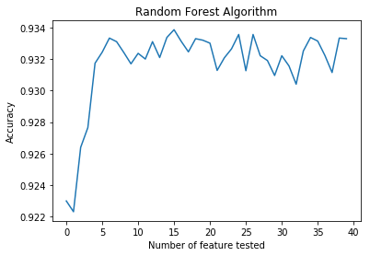
Random Forest Accuracy

Slide 17
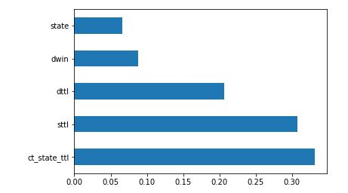
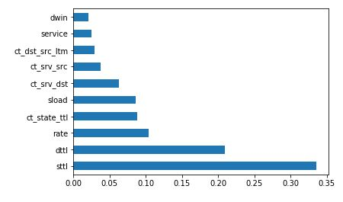
Optimal Ratio
n=10
n=5

Slide 18
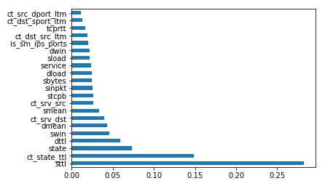
Optimal Ratio
n=10
n=5
n=21

Slide 19
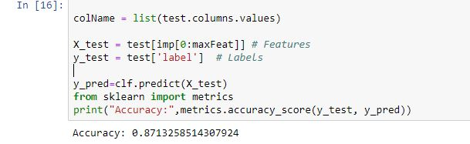
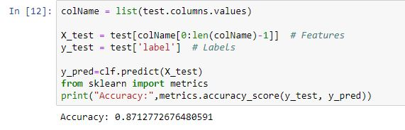
n=21

Slide 20
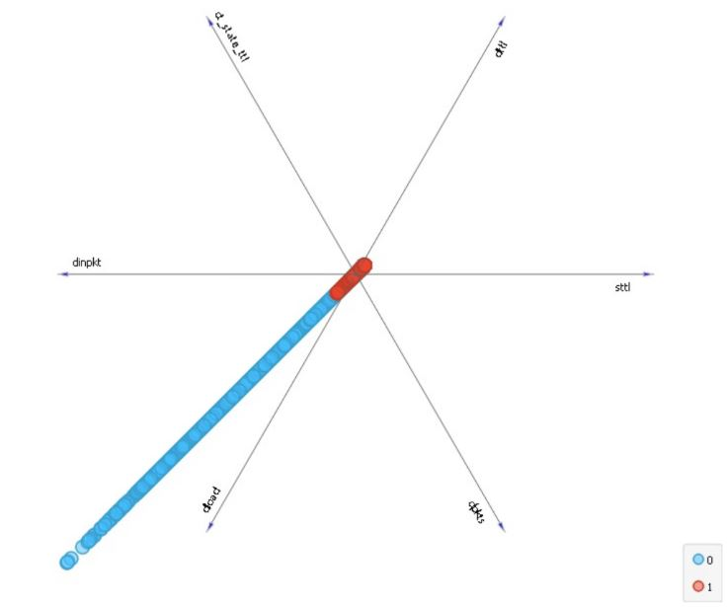
Final Classification

Slide 21
Conclusion
It can be clearly seen from the experimental results that all the techniques have been applied and dealt with. It can also be clearly seen that the Random Forest Classifier outperformers all the other techniques in terms of accuracy.
Further, the technique has been applied to a group photo and there too a reasonable amount of accuracy has been obtained. Thus, it can be said that Random Forest Classifier (RFC) can provide a fair amount of information regarding the possible occurrence of an attack and thus can be used in places of interest to detect and stop any kind of emergency before it occurs.
As for our future, we have currently detected the labels on whether there is an attack or not and thus further plan to implant the algorithm to further classify which kind of attack it is.

Slide 22
References
Baras, John S., and Maben Rabi. “Intrusion Detection with Support Vector Machines and Generative Models.” Lecture Notes in Computer Science Information Security, 2002, pp. 32–47., doi:10.1007/3-540-45811-5_3.
Marchal, Samuel, et al. “A Big Data Architecture for Large Scale Security Monitoring.” 2014 IEEE International Congress on Big Data, 2014, doi:10.1109/bigdata.congress.2014.18.
Moustafa, Nour, and Jill Slay. “UNSW-NB15: a Comprehensive Data Set for Network Intrusion Detection Systems (UNSW-NB15 Network Data Set).” 2015 Military Communications and Information Systems Conference (MilCIS), 2015, doi:10.1109/milcis.2015.7348942.

